Slide 1
MACHINERY MAINTENANCE WEB APPLICATION SYSTEM
10899668-Panadura A Premathilaka

Slide 2

PROBLEM STATEMENT
Manual tracking of machinery maintenance using physical paper-based system.
Supervisors struggle to monitor machine status, assign tasks efficiently, and ensure maintenance schedules are followed.
Technicians face delays and confusion due to missing, inaccurate, or outdated service records.
Inventory Employees have difficulty tracking material stock levels and responding to urgent maintenance requests without real-time data.
10899668-Panadura A Premathilaka

Slide 3

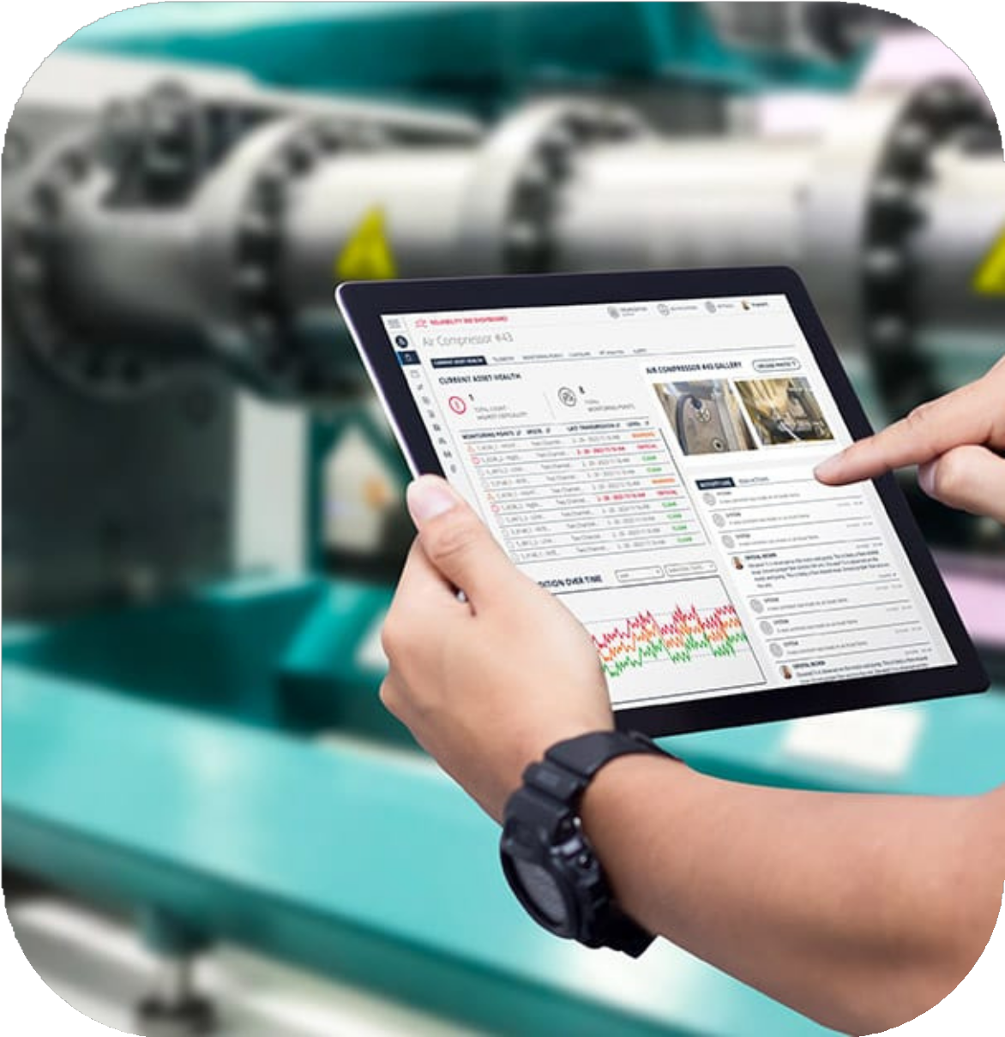
OBJECTIVES
Develop a centralized web app for machinery maintenance
Notify supervisors about upcoming services
Enabling technician to report meter readings and maintenance
Track material usage and improve inventory Management.
Send email notifications for maintenance reminders
10899668-Panadura A Premathilaka

Slide 4


SCOPE
User Authentication
Machine registration Meter reading updates Maintenance scheduling
Assigning Technicians to tasks Create service logs
Material inventory tracking Role-based dashboards Email for upcoming services
Excluded
IoT sensor integration
10899668-Panadura A Premathilaka

Slide 5



LITERATURE REVIEW
Gaps Identified:
Existing systems (e.g., IBM Maximo, SAP PM) are too complex and costly for SMEs.
No built-in inventory/material tracking in many basic apps — causes delays and shortages.
Insufficient reporting and analytics for long-term maintenance planning and decision-making.
VALUE ADDITION OF MACHNIX:
Designed specifically for SMEs — affordable, simple, and effective.
Role-based dashboards for supervisors, technicians, and inventory staff.
Supports proactive decision-making with historical data and reports.
Sends email notifications to technicians about upcoming maintenance, ensuring no task is missed.
centralized records, and inventory tracking.
10899668-Panadura A Premathilaka

Slide 6
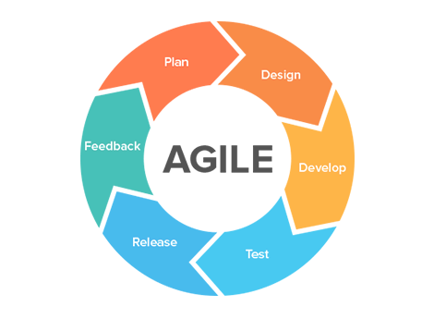
METHODOLOGY
Approach
Agile Methodology
Process
Planning - Gathered initial requirements and feedback to define core features.
Designing - user feedback helped improve layout and usability.
Developing -
Collected continuous feedback from stakeholders
10899668-Panadura A Premathilaka

Slide 7
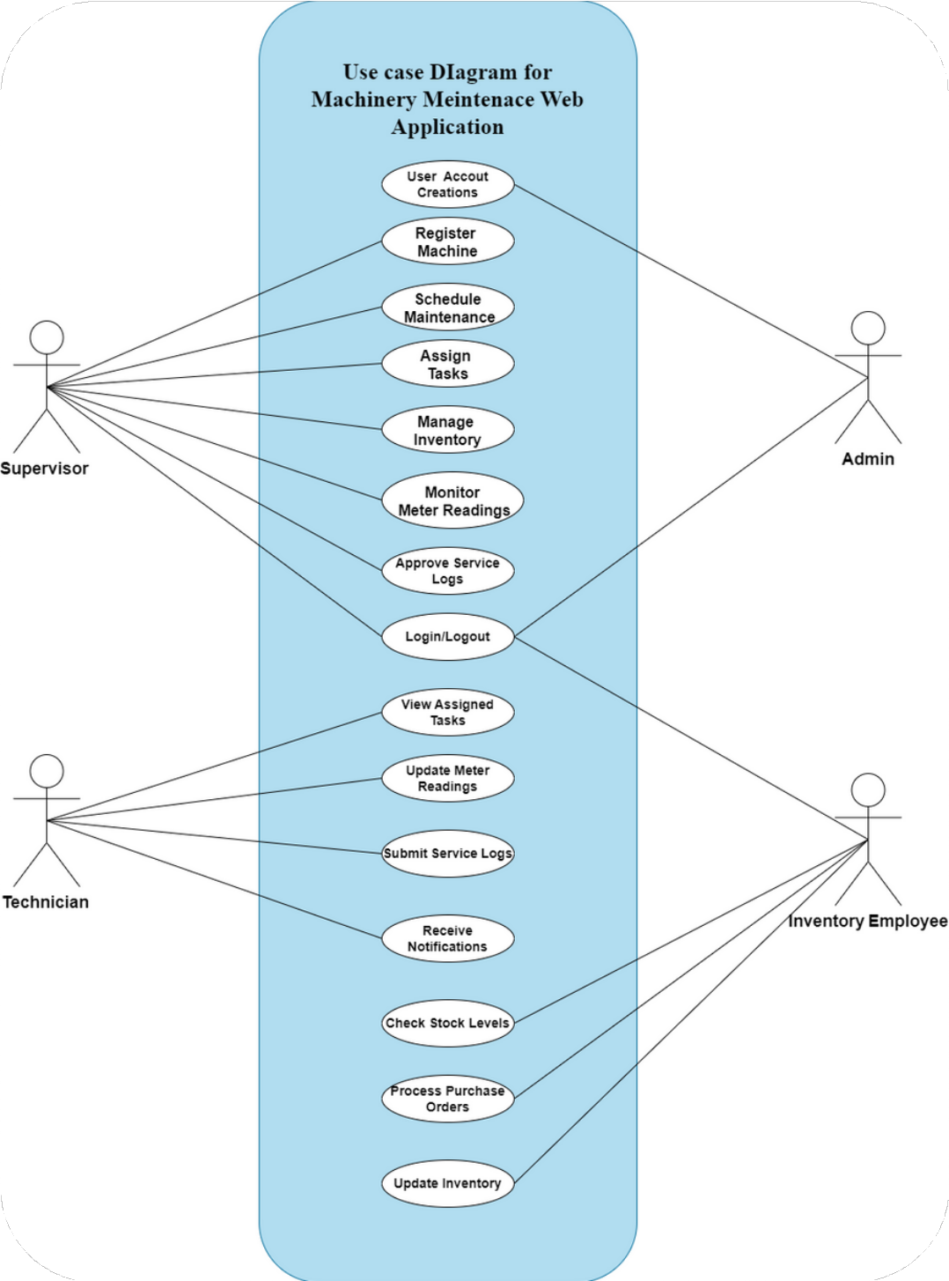
SYSTEM DESIGN
Use Case Diagram
User roles-
Admin Supervisor Technician
Inventory Employee
10899668-Panadura A Premathilaka

Slide 8
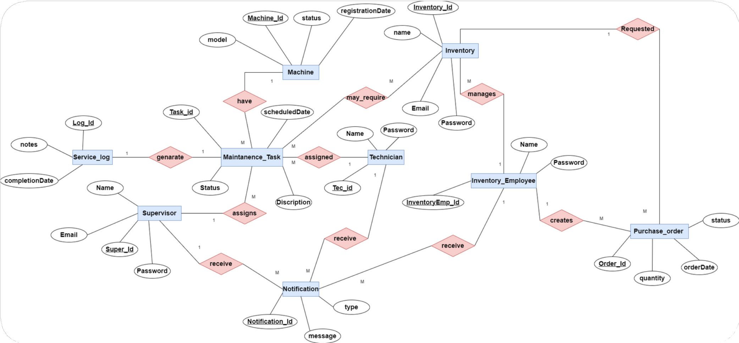
SYSTEM DESIGN
ER diagram
10899668-Panadura A Premathilaka

Slide 9
SYSTEM DESIGN
Class Diagram
10899668-Panadura A Premathilaka

Slide 10



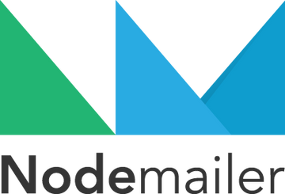





IMPLEMENTATION
Front-end
Next. js-
React-based framework , server-side rendering (SSR) typescript, tailwind css
Backend
Node.js -
API requests and responses, User authentication, CRUD operations for machinery, tasks, inventory
Database
Firebase - NoSQL cloud database (Firestore) User data and roles
Machine records Maintenance tasks and logs Inventory and stock levels
Email Notifications
Nodemailer (for sending automated maintenance and material alerts)
Hosting
Netlify , Github
10899668-Panadura A Premathilaka

Slide 11
KEY FEATURES OF
MACHNIX
Role-Based Login & Dashboards
Admin - manages users, monitors system activity
Supervisors - Assign technicians, manage machinery, view reports, and approve material requests
Technicians - Update meter readings, log maintenance tasks, and view assigned schedules.
Inventory Employees - Manage stock levels, handle material requests, and process purchase planning.

Slide 12


KEY FEATURES OF MACHNIX
Machine Registration
Add machines with details like brand, model, and unique ID; store in a centralized database.
Meter Reading Updates
Daily readings for usage tracking; helps schedule preventive maintenance based on actual machine hours.
Preventive Maintenance Scheduling
Recurring maintenance tasks can be scheduled based on usage or time intervals.
Maintenance History Logging
Tracks all past services, repairs, and parts used — accessible for audits or decision-making.
Inventory Management
Add, edit, and track maintenance materials (e.g., oils, parts); real-time stock status displayed.
Material Request & Approval
Operators request materials; supervisors or inventory staff approve and restock if needed.
Real-Time Notifications
Automated service alerts via Nodemailer (email) to prevent missed maintenance.

Slide 13

TESTING AND EVALUATION
Testing Types
Manual Functional Testing All core features (e.g., login, notifications, machine registration, meter updates) are tested manually.
Tools Used
Manual Testing (Browser-based interaction) Firebase Console (for real-time data validation) Basic UI walkthroughs and form validation checks
Results
Core modules functioned as expected.
Role-based access and data visibility were accurate. Email alerts and notifications are properly activated.

Slide 14

RESULTS AND OUTCOMES
Successful replacement of a manual, paper-based system
Real-time tracking of meter readings and service status. Improved documentation and preventive planning.
Reduced missed services and improved timely execution.
Role-based dashboards ensure everyone sees only what's relevant to them.
Environmentally friendly outcome.

Slide 15

LIMITATIONS
No integration with IoT or sensors
Basic analytics lacks advanced charts, trends, or predictive maintenance insights. not provide advanced analytics -
Trend analysis ( Failure frequency over time)
Predictive insights ( When a machine is likely to fail next)
Cross-reporting (Comparing performance across different machines or periods)
No AI-driven suggestions or automated anomaly detection. No API-based vendor management

Slide 16


FUTURE ENHANCEMENTS
IoT sensor integration for real-time readings
Advanced analytics and reporting, including: Trend analysis on service frequency and costs
Predictive maintenance suggestions based on usage patterns Cross-machine performance comparison
Interactive data visualization tools (charts, graphs, heatmaps).

Slide 17
Conclution
A user-friendly, scalable solution designed specifically for SMEs -
Designed to satisfy small and mid-sized organizations' practical requirements without being overly complex.
improves methods for preventative maintenance -
allows supervisors to customize maintenance schedules and send email alerts to make sure machinery is maintained in good condition and connected on schedule.
Reduces machinery downtime and operational inefficiencies
Ensures timely maintenance, reduces breakdowns, and enhances resource planning.
Enables informed decision-making
Real-time data and historical reports support proactive planning and performance tracking.
Streamlines inventory and material management
Avoids service delays due to missing materials through timely stock monitoring and purchase planning.
Supports a sustainable and paperless process
follows with existing environmental standards by doing away with the requirement for printed logs and forms.

Slide 18


